Slide 1
MVCH DATABASE
Albert Carter
Di Huang
Zihang Pu
Cong Wu

Slide 2
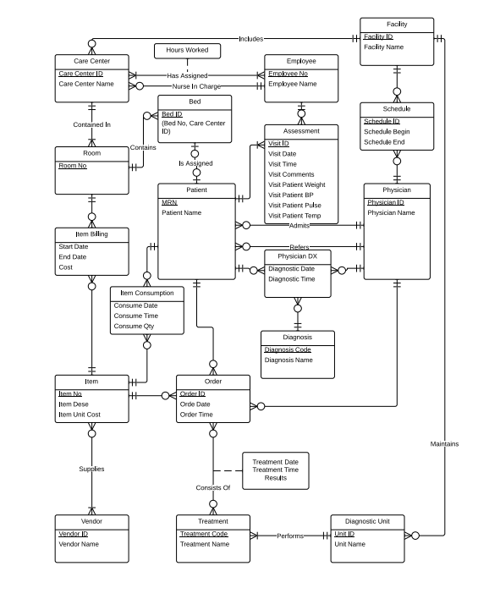
ER Diagram

Slide 3
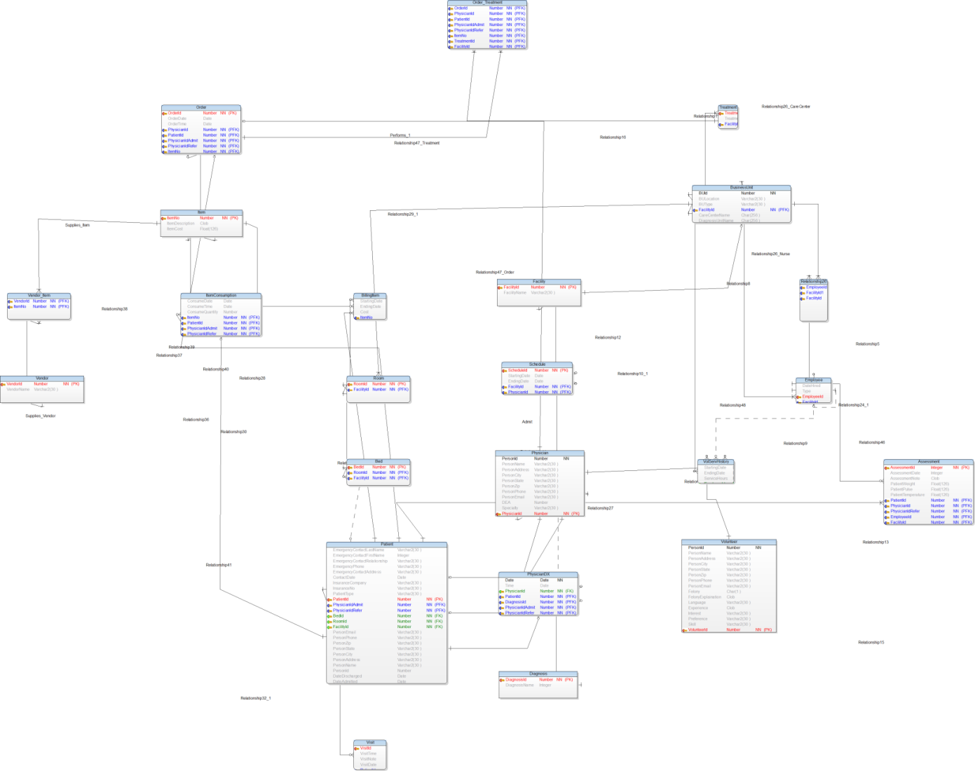
EER Diagram

Slide 4
Business Rules Snippets
A DIAGNOSTIC UNIT performs one or many TREATMENTs.
A TREATMENT is performed by only one DIAGNOSTIC UNIT.
A FACILITY can have zero, one or many CARE CENTERs.
A CARE CENTER is part of one and only one FACILITY.
A FACILITY can have zero, one or many DIAGNOSTIC UNITs.
A DIAGNOSTIC UNIT is part of only one FACILITY.
A CARE CENTER has one or many EMPLOYEEs.
A CARE CENTER has one EMPLOYEE assigned as morning nurse in charge.
A CARE CENTER has one EMPLOYEE assigned as nighttime nurse in charge.
A CARE CENTER contains one or many ROOMs.
A ROOM is inside only one CARE CENTER.
A ROOM has zero, one, or many BEDs.
A BED is inside only one ROOM.

Slide 5
Relational Schema
DIAGNOSTIC_UNIT(DUnitName)
TREATMENT(TrtID, TrtName, DUnitName)
INSURANCE_COMPANY (InsuranceNo, InsName, InsAddress, InsPhone)
FACILITY (FacID, FacName)
PERSON(PID, PName, PDOB, PEmail, PAdd1, PAdd2, PCity, PState, PZip, PHomePhone, PWorkPhone, IsPhysician, IsPatient, IsEmployee, IsVolunteer)
PHYSICIAN (PhysicianID, CellNo, PagerNo, DEANo, Specialty)
PATIENT (PatientID, AdmitPhysician, ReferPhysician, InsuranceNo, EmergencyPersonID, EmergencyPersonRelation, InsFName, InsLName, OutInPatient,
RESIDENT (RPatientID, BedNo, RoomNo, AdmitDate, DischargeDate)
OUTPATIENT(OPatientID)
NURSE (NurseID, CertDegree, StateLicenseNo, NurseSpeciality, NurseType)
RN (RNID)
LN (LNID, Supervisor)
FIELD_CERTIFICATION (FCID, NurseID, FCDescription)

Slide 6
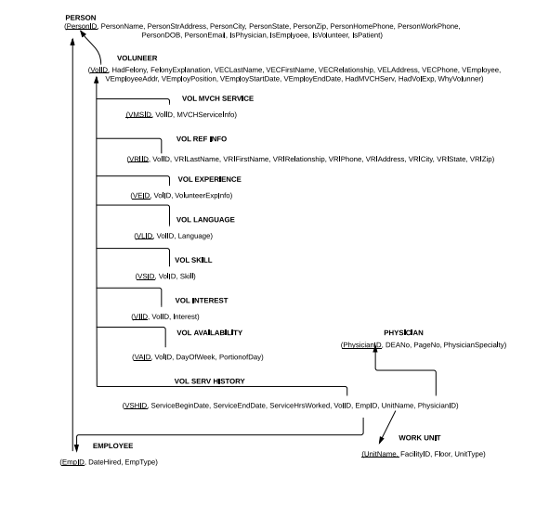
Functional Dependencies

Slide 7
SQL table creation code (creation.sql)
CREATE TABLE Patient(
...
InsuranceNo Varchar2(30 ),
PatientType Varchar2(30 ) CONSTRAINT ValidValuesPatientType CHECK ((PatientType IN ('Outpatient','Resident','Discharged'))),
PatientId Number NOT NULL,
PhysicianIdAdmit Number NOT NULL,
...
DateAdmitted Date
);
ALTER TABLE Patient ADD CONSTRAINT Unique_Identifier2 PRIMARY KEY (PatientId,PhysicianIdAdmit,PhysicianIdRefer);
CREATE TABLE Physician(
PersonId Number NOT NULL,
...
Specialty Varchar2(30 ),
PhysicianId Number NOT NULL
);
ALTER TABLE Physician ADD CONSTRAINT Unique_Identifier3 PRIMARY KEY (PhysicianId);
CREATE TABLE Employee(
DateHired Date,
Type Varchar2(30 ) CONSTRAINT ValidValuesType CHECK ((Type IN ('NURSE','STAFF'))),
...
NurseType Varchar2(30 )
CONSTRAINT ValidValuesNurseType CHECK ((NurseType IN ('REGISTERED','LICENSED'))),
...
Degree Varchar2(30 )
);
ALTER TABLE Employee ADD CONSTRAINT Unique_Identifier4 PRIMARY KEY (EmployeeId,FacilityId);
CREATE TABLE Visit(
VisitId Number NOT NULL,
VisitTime Date,
...
PhysicianIdRefer Number NOT NULL
);
ALTER TABLE Visit ADD CONSTRAINT Unique_Identifier10 PRIMARY KEY (VisitId,PatientId,PhysicianIdAdmit,PhysicianIdRefer);
CREATE TABLE Bed(
....

Slide 8
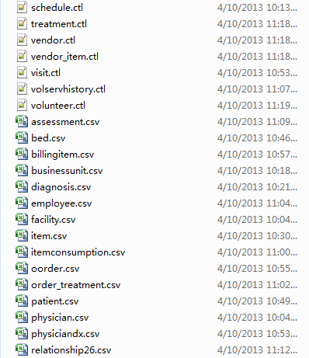
Sqlloader Data&control files

Slide 9
Sql Loader central.bat file
sqlldr dee/password control=physician.ctl
sqlldr dee/password control=facility.ctl
sqlldr dee/password control=schedule.ctl
sqlldr dee/password control=businessunit.ctl
sqlldr dee/password control=diagnosis.ctl
sqlldr dee/password control=treatment.ctl
sqlldr dee/password control=item.ctl
sqlldr dee/password control=vendor.ctl
sqlldr dee/password control=volunteer.ctl
sqlldr dee/password control=vendor_item.ctl
sqlldr dee/password control=room.ctl
sqlldr dee/password control=bed.ctl
sqlldr dee/password control=patient.ctl
sqlldr dee/password control=visit.ctl
sqlldr dee/password control=physiciandx.ctl
sqlldr dee/password control=oorder.ctl
sqlldr dee/password control=billingitem.ctl
sqlldr dee/password control=itemconsumption.ctl
sqlldr dee/password control=order_treatment.ctl
sqlldr dee/password control=employee.ctl
sqlldr dee/password control=volservhistory.ctl
sqlldr dee/password control=assessment.ctl
sqlldr dee/password control=relationship26.ctl
Pause

Slide 10
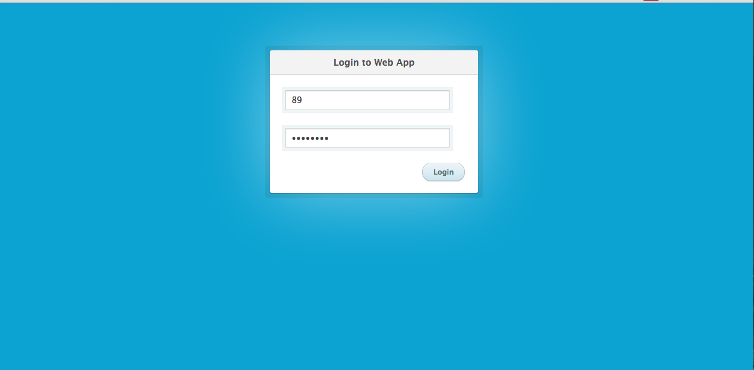
Web Application Login

Slide 11
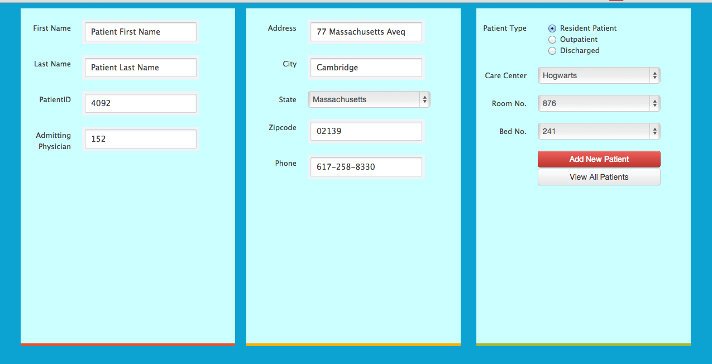
Add (Insert) a Patient

Slide 12
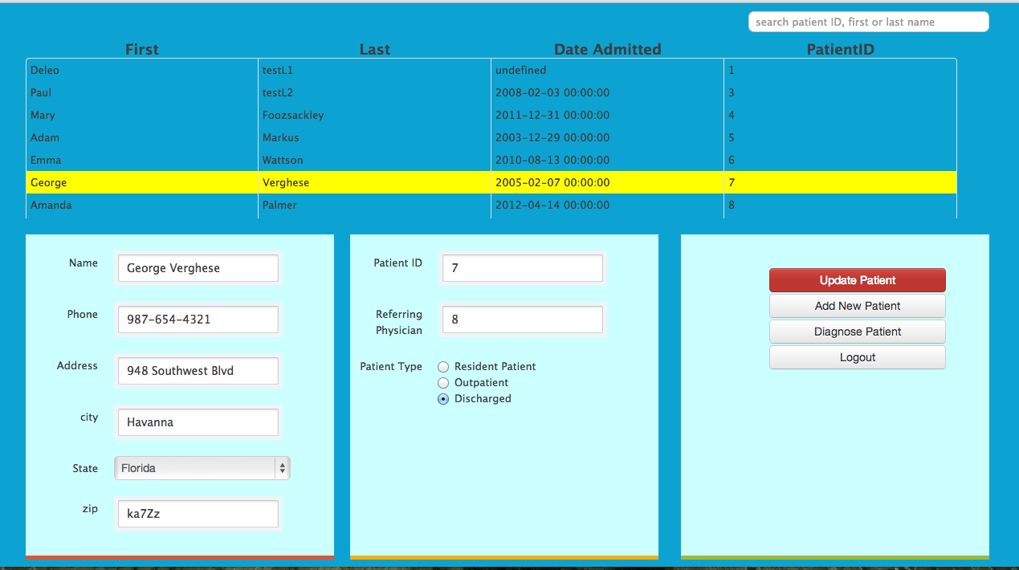
Query & Update Patients

Slide 13
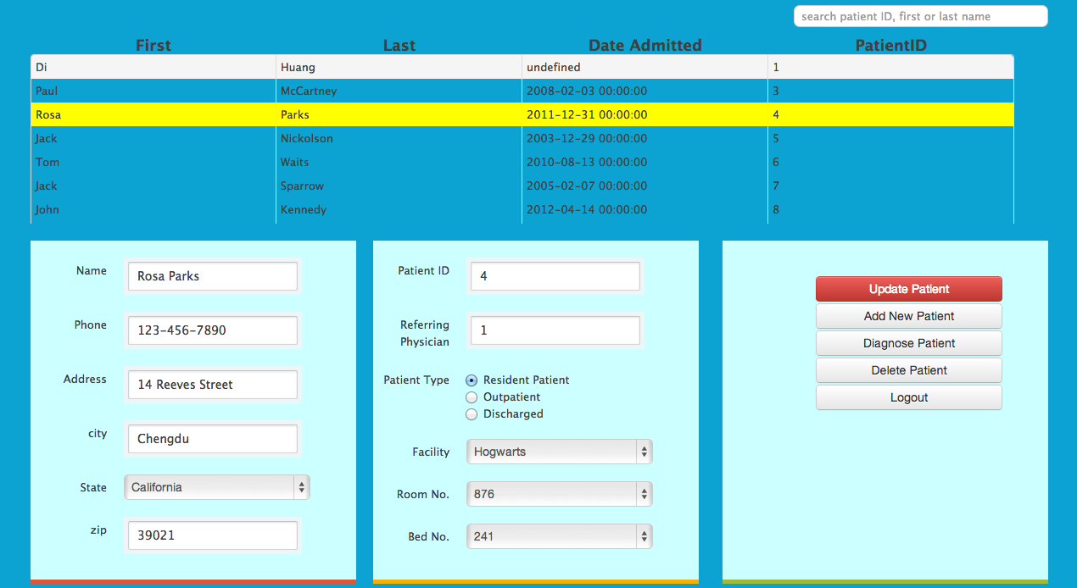
Delete Patient

Slide 14
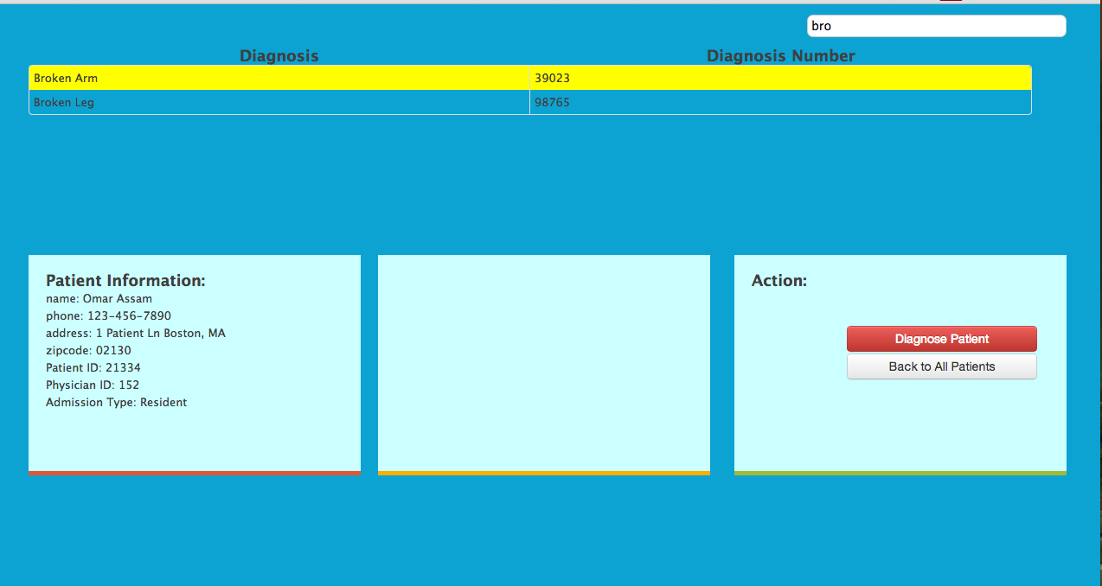
Diagnose Patients

Slide 15
Technologies & Softwares Used
Oracle 11g
SQL Loader
Toad Data Modeler
Spring Tool Suite
CoffeeScript
Javascript
jQuery
HTMl & CSS

Slide 16
Group Work Distribution
Cong
EER Diagram
Spring web integration
Al
Business Rules
Relational Schema
Front-end Development
Di
Table Data Creation
SQL Loader integration
Zihang
ER Diagram, Functional Dependencies Development
JDBC connection

Slide 17
Lessons Learned
Developing locally is much easier than remote.
Django with Oracle was too hard. We eventually used Java.
Learned to configure oracle listener.
Learned to use Amazon’s AWS RDS Learned to use Amazon’s AWS Elastic Beanstalk
Learned that the more complex a database is, the more complex the project becomes.
Learned that security of the database is extremely time consuming.
Learned that you should always have a database backup.

Slide 18
ER Diagram

